Slide 1
Survival models in a dynamic context: a survey (2004 Elsevier B.V.)
老師：戴天時
學生：謝昌宏

Slide 2
1. Introduction
This paper ﬁrst aims at describing some aspects of the development of survival modeling in actuarial mathematics, focussing on various approaches to mortality assumptions in a moving scenario.
Secondly, special emphasis is placed on a “new” type of risk affecting the management of life insurance and annuities, i.e. the longevity risk, which originates from the uncertainty in future mortality trends.

Slide 3
2. Modeling dynamic mortality: basic ideas and early contributions
2.1. Some preliminary ideas
the annual probabilities of death q_{x}, or the force of mortality µ_{x}
From the qx’s, a survival table is then derived as follows:
ω is the assumed maximum age (105 or 110,say) and, for example, l₀ = 100,000, or l₀ = 1

Slide 4
2. Modeling dynamic mortality: basic ideas and early contributions
Using the force of mortality, the survival function is given, for x > 0, by
In many countries, statistical evidence show that human mortality declined over the 20th century, and in particular over its last decades. So, an hypothesis of “static” mortality, as implicitly involved by (2.1) and (2.2), cannot be assumed in principle.

Slide 5
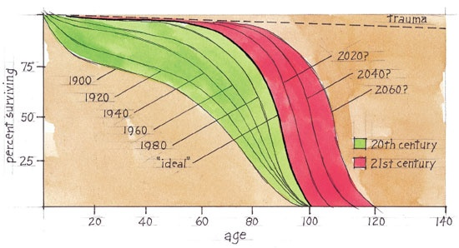
2. Modeling dynamic mortality: basic ideas and early contributions
2.2.

Slide 6
2. Modeling dynamic mortality: basic ideas and early contributions
(a) a “vertical” arrangement (i.e. by columns),
 | Age
Year

Slide 7
2. Modeling dynamic mortality: basic ideas and early contributions
(b) a “diagonal” arrangement,
(c) a “horizontal” arrangement (i.e. by rows),
 | Age
Year

Slide 8
2. Modeling dynamic mortality: basic ideas and early contributions
2.5. Early seminal contributions to mortality forecast
As Cramér and Wold (1935) notes, in 1924 the Institute of Actuaries in London proposed a “horizontal” method for mortality projection, assuming for the annual probability of death the following expression:

Slide 9

2. Modeling dynamic mortality: basic ideas and early contributions
For instance, let us set a_{x} = 0, ,
c_{x} =r_{x}, where y’ denotes the current (or “reference”) year and r_{x} represents the annual rate of mortality improvement (if r_{x} < 1) at age x, the so-called “reduction factor”; then we obtain

Slide 10

2. Modeling dynamic mortality: basic ideas and early contributions
Moreover, with
we ﬁnd
where represents (if r_{x} < 1) the asymptotic mortality at age x. For more details; see also Section 3.5.

Slide 11
3. Modern contributions and research in progress
3.1. Mortality forecast: contributions from demography
Let us suppose that the existence of an “optimal” life table is assumed. The relevant age pattern of mortality must be meant as the limit to which mortality improvements can lead.

Slide 12

3. Modern contributions and research in progress
Let denote the limit probability of death at age x, whereas q_{x}(y’) denotes the current mortality. Assume then that the projected mortality q_{x}(y) is expressed as follows:
where the symbol F denotes some interpolation formula.

Slide 13
3. Modern contributions and research in progress
In particular, an exponential interpolation canbe adopted, leading, for example, to:
with r_{x} < 1.
Notes:
so that an analysis of mortality by causes of death is required.

Slide 14

3. Modern contributions and research in progress
A new way to mortality forecasts was paved by the “relational method” proposed by Brass. In order to express relationships among mortality of various populations, Brass (1974) focussed on the logit transform of the survival function, namely

Slide 15

3. Modern contributions and research in progress
Petrioli and Berti proposed transform is the “resistance function” (see Petrioli and Berti, 1979; Keyﬁtz, 1982), deﬁned as follows:
where ω denotes the maximum age. Thus, the transform is the ratio of the average annual probability of death beyond age x to the average annual probability of death prior to age x.

Slide 16
3. Modern contributions and research in progress
3.2. Some remarks
Early projection methods disregard the stochastic nature of (observed) mortality and provide the forecaster only with point estimates of future mortality.
It is possible to build stochastic models recognizing the observed mortality rates as estimates, and allowing for an interval estimation of future mortality rates.

Slide 17
3. Modern contributions and research in progress
Uncertainty in future mortality rates is ﬁrst attributable to random ﬂuctuations around the relevant point estimates, namely to “process risk”.
Because the relevant parameters or the structure of the model itself do not reﬂect the actual mortality trend. Hence, a “parameter risk” and a “model risk” should be allowed for when projecting mortality.

Slide 18
3. Modern contributions and research in progress
3.3. Parametric models
In particular, Brouhns et al. (2002a) stress that. the estimated parameters are often strongly dependent
Hence, univariate extrapolation of the parameters may be misleading, whereas a multivariate time series for the parameters is theoretically possible but can lead to computational intractability.

Slide 19

3. Modern contributions and research in progress
3.5. Mortality forecast via reduction factors
For example, in the UK actuarial practice projected probabilities of death are expressed as follows:
The following reduction factor has been recently adopted (see CMIR17, 1999):

Slide 20
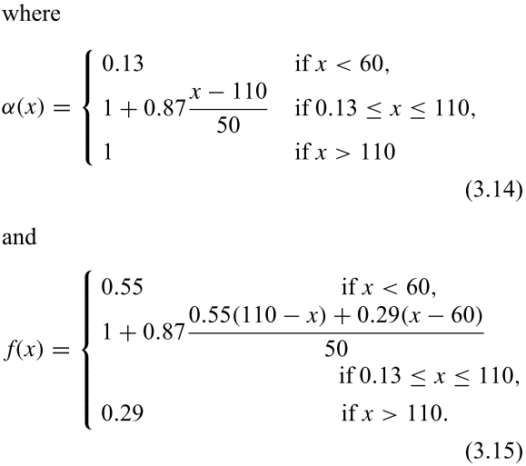
3. Modern contributions and research in progress
60
60

Slide 21
3. Modern contributions and research in progress
Reduction factors are constructed without a speciﬁc modeling structure. The calculation of the reduction factors is based on a 20-year time span, with the origin y’ located one-and-a-half year into the base quadriennium 1991–1994.

Slide 22
3. Modern contributions and research in progress
3.6. Mortality at very old ages
A ﬁrst problem obviously concerns the observed old-age mortality rates, heavily affected by random ﬂuctuations because of their scarcity.
As classical mortality laws may fail in representing the very old-age mortality.

Slide 23
3. Modern contributions and research in progress
3.7. Further issues
In particular, it should be stressed that complex interrelationships exist among causes of death, whilst the assumption of independence is commonly accepted.
When projecting mortality, collateral information available to the forecaster can be allowed for.

Slide 24
4. The longevity risk
4.1. Modeling the uncertainty in mortality trends
let Γ(x, y) denote a projected mortality model, born in year τ = y − x. Denote by K(τ) a given assumption about the mortality trend for people born in year τ, and by K(τ) the set of such hypotheses.

Slide 25
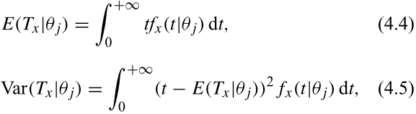
4. The longevity risk
let us consider the residual lifetime T_{x}. According to a given choice θ_{j} of the parameter, the (conditional) moments of T_{x} may be evaluated. In an age-continuous context, we have,
where fx(t|θj) is the (conditional) pdf of the residual lifetime Tx.

Slide 26
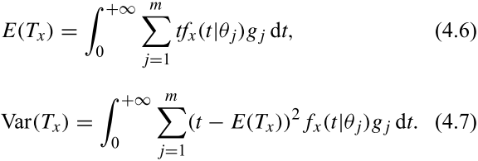
4. The longevity risk
The unconditional moments are then as follows:

Slide 27
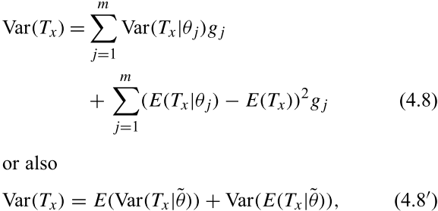
4. The longevity risk
In particular, the following well-known result can be obtained for the variance developing expression (4.7):
where ˜θ denotes the random value of the parameter.

Slide 28
4. The longevity risk
4.3. The longevity risk: actuarial evidence
We focus on solvency requirements for life annuities portfolios (and funded pension plans). Solvency is investigated referring to immediate annuities.

Slide 29

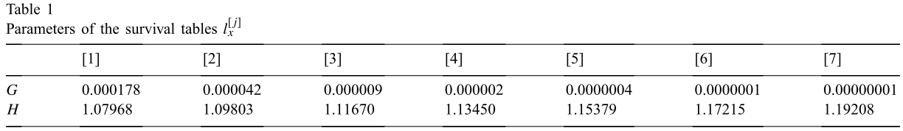
4. The longevity risk
From (4.10) the survival table lx can be obtained.
Seven survival tables l , j =1, 2, . . . , 7, have been deﬁned, to describe different mortality scenarios.

Slide 30
4. The longevity risk
a “deterministic” approach, implemented by using a given projected survival table; this approach only allows for the random ﬂuctuation risk;
a “stochastic” approach, implemented by using a set of projected survival tables; this approach allows for both the random ﬂuctuation risk and the longevity risk.

Slide 31

4. The longevity risk
4.3.2. A deterministic approach to mortality risks
In order to obtain results easier to interpret, we disregard proﬁt; the actual life duration of the annuitants is thus simulated with the survival table .
ε = 0.025

Slide 32
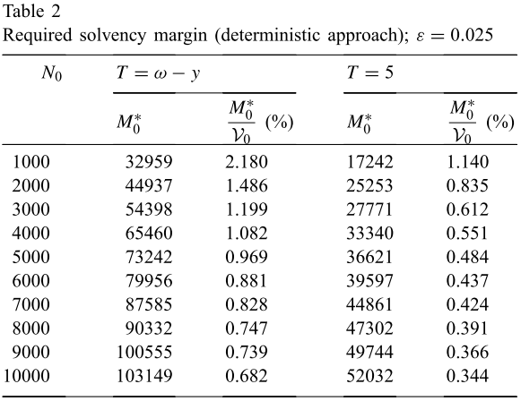
4. The longevity risk
(65)

Slide 33

4. The longevity risk
4.3.3. A stochastic approach to mortality risks
we consider the survival tables , j = 1, 2, . . . , 7, assuming that each of them is meant as a possible probability distribution of the future lifetime. A weight g_{j}, j = 1, 2, . . . , 7, is assigned to each survival table, representing the relevant

Slide 34


4. The longevity risk

Slide 35
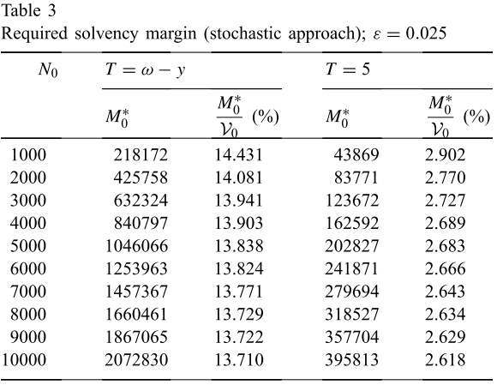
4. The longevity risk

Slide 36

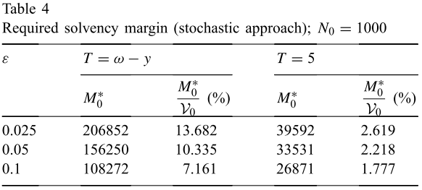

Slide 37
Research Direction
Add continuous mortality rate to our model.
  (static => dynamic)
  Continuous vs. Dispersed
Progress
  Mortality data
  Review the paper about GMWB with mortality

Slide 38
Progress
Data Source:
HMD (Human Mortality Database from University of Berkeley)

Slide 39
Thanks
End

